Slide 1
Illinois Perkins Performance Indicators Report
CIRR #425 Calhoun, Greene, Jersey, Macoupin

Slide 2
Perkins Indicators Codes and Definitions
Indicator Descriptions | Indicator Codes | Indicator Names
Secondary Level
The percentage of CTE concentrators who graduate high school, as measured by the four-year adjusted cohort graduation rate (defined in section 8101 of the Elementary and Secondary Education Act of 1965). | 1S1 | Four-Year Graduation Rate
(At the State’s discretion – IL six-year) The percentage of CTE concentrators who graduate high school, as measured by extended-year adjusted cohort graduation rate defined in such section 8101 | 1S2 | Extended Graduation Rate
CTE concentrator proficiency in the challenging State academic standards adopted by the State under section1111(b)(1) of the Elementary and Secondary Education Act of 1965, as measured by the academic assessments in reading/language arts as described in section 1111(b)(2) of such Act. | 2S1 | Academic Proficiency in Reading/Language Arts
CTE concentrator proficiency in the challenging State academic standards adopted by the State under section1111(b)(1) of the Elementary and Secondary Education Act of 1965, as measured by the academic assessments in mathematics as described in section 1111(b)(2) of such Act. | 2S2 | Academic Proficiency in Mathematics
CTE concentrator proficiency in the challenging State academic standards adopted by the State under section1111(b)(1) of the Elementary and Secondary Education Act of 1965, as measured by the academic assessments in science as described in section 1111(b)(2) of such Act. | 2S3 | Academic Proficiency in Science
The percentage of CTE concentrators who, in the second quarter after exiting from secondary education, are in postsecondary education or advanced training, military service, or a service program that receives assistance under title I of the National and Community Service Act of 1990 (42 U.S.C. 12511 et seq.), are volunteers as described in section 5(a) of the Peace Corps Act (22 U.S.C. 2504(a)), or are employed. | 3S1 | Post-Program Placement
The percentage of CTE concentrators in career and technical education programs and programs of study that lead to non-traditional fields. | 4S1 | Non-traditional Program Concentration
The percentage of CTE concentrators graduating from high school having attained a recognized postsecondary credential. | 5S1 | Attained Recognized Postsecondary Credential
The percentage of CTE concentrators graduating from high school having attained postsecondary credits in the relevant career and technical education program or program of study earned through dual or concurrent enrollment or another credit transfer agreement | 5S2 | Attained Postsecondary Credits
The percentage of CTE concentrators graduating from high school having participated in work-based learning | 5S3 | Participated in Work-Based Learning

Slide 3
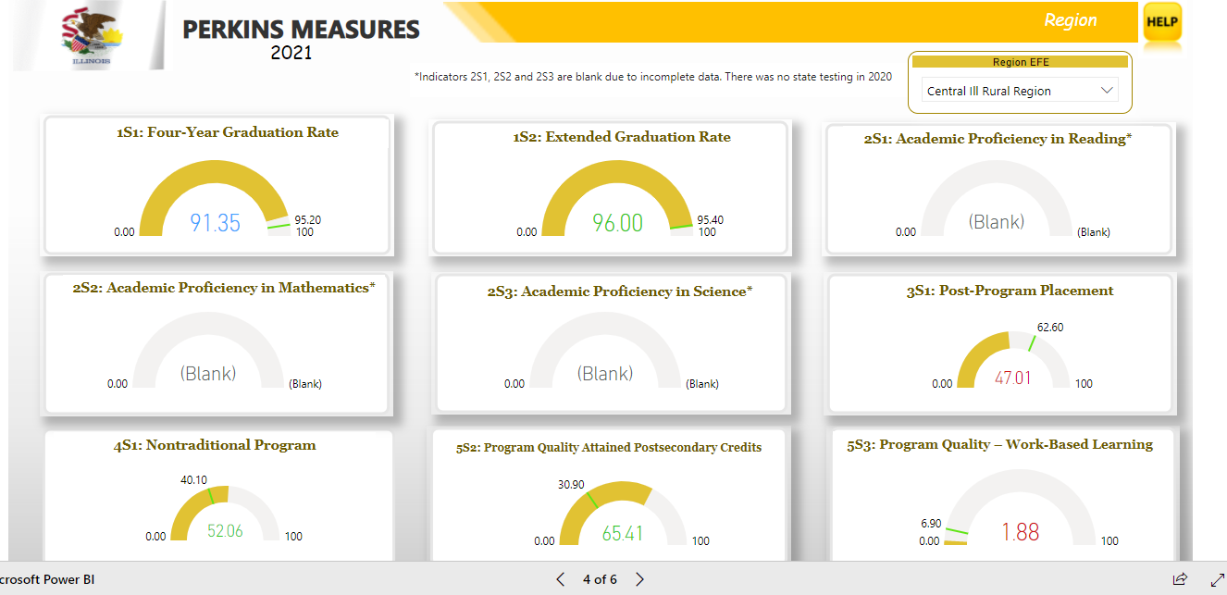
Region-wide Perkins Indicator Data for CIRR #425
Scoring color-coded key
Met Indicator Target | Met 90% Target | Indicator Target Not Met

Slide 4
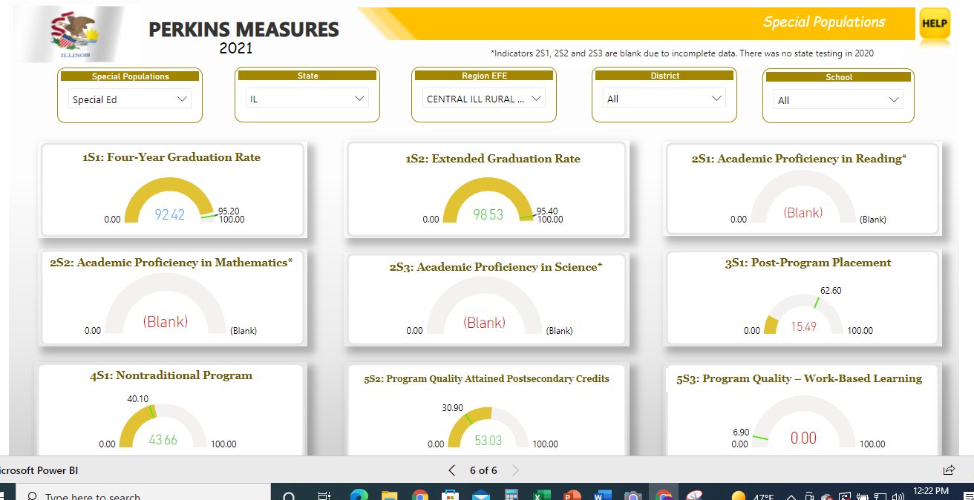
Special Populations Perkins Indicator Data for CIRR #425
Scoring color-coded key
Met Indicator Target | Met 90% Target | Indicator Target Not Met

Slide 5
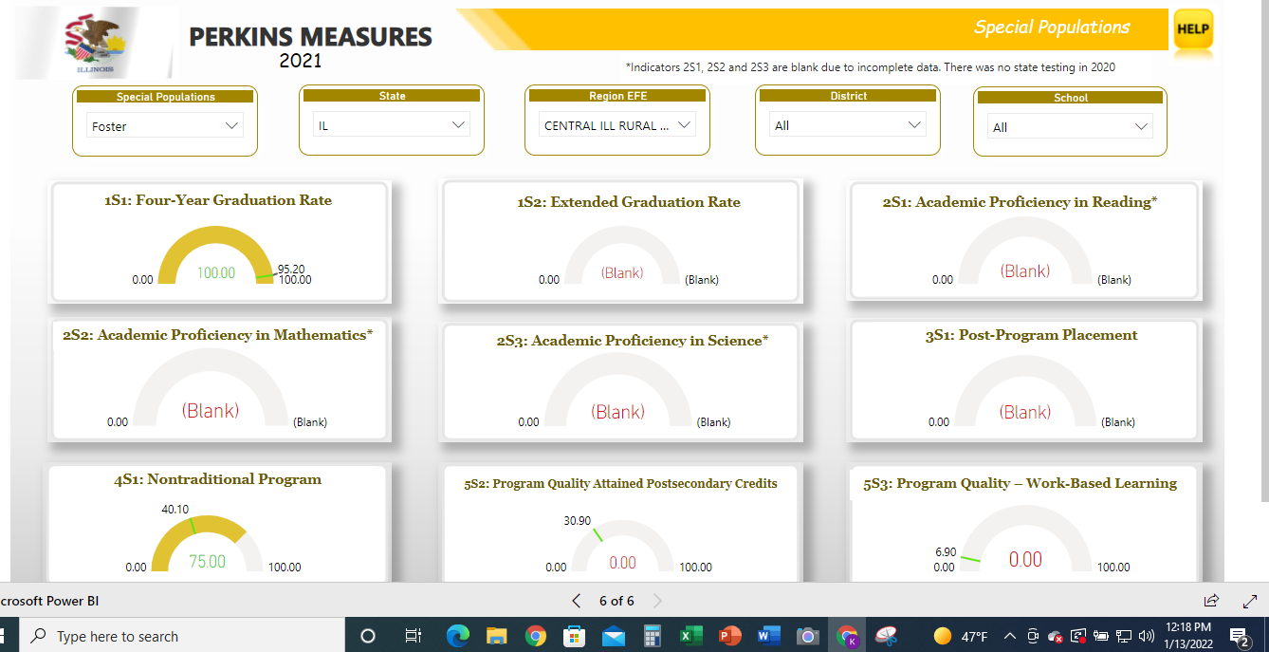
Special Populations Perkins Indicator Data for CIRR #425
Scoring color-coded key
Met Indicator Target | Met 90% Target | Indicator Target Not Met

Slide 6
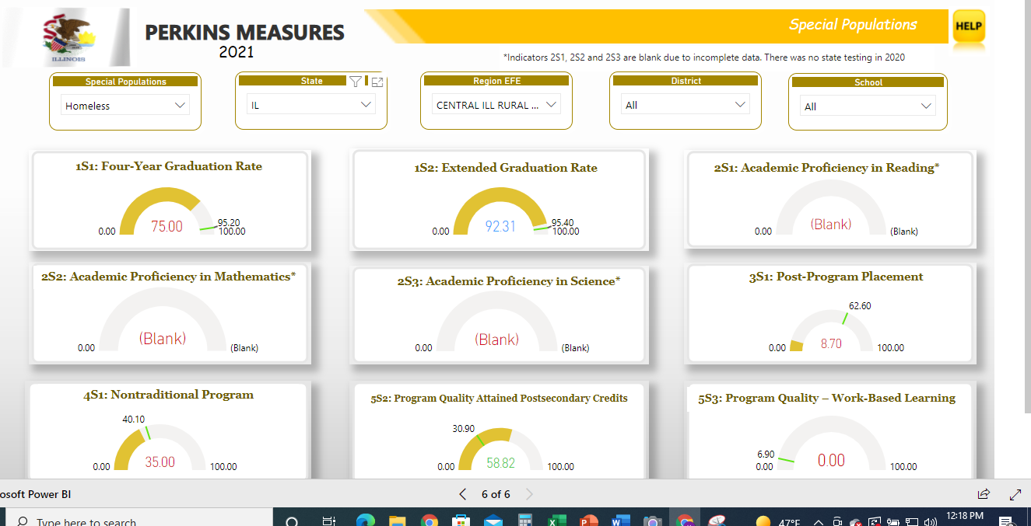
Special Populations Perkins Indicator Data for CIRR #425 CTE
Scoring color-coded key
Met Indicator Target | Met 90% Target | Indicator Target Not Met

Slide 7
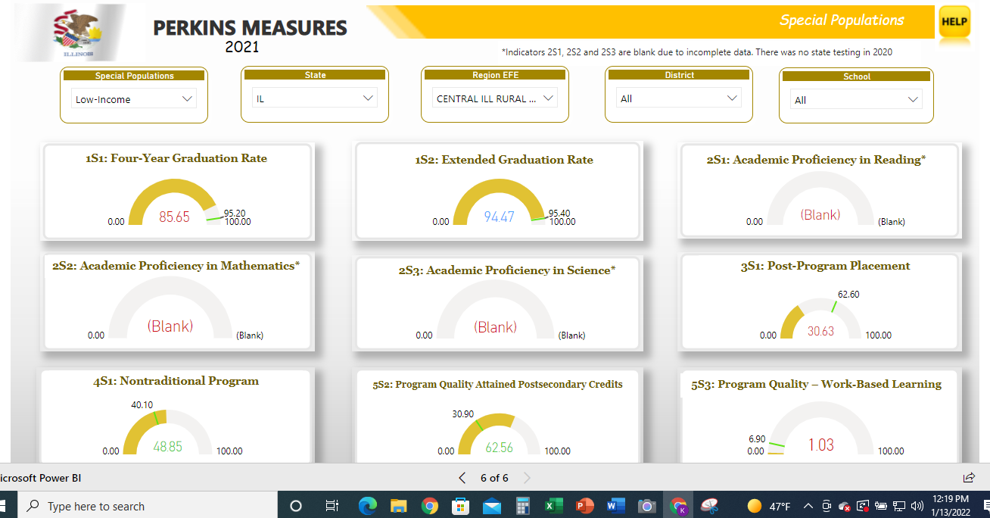
Special Populations Perkins Indicator Data for CIRR #425 CTE
Scoring color-coded key
Met Indicator Target | Met 90% Target | Indicator Target Not Met

Slide 8
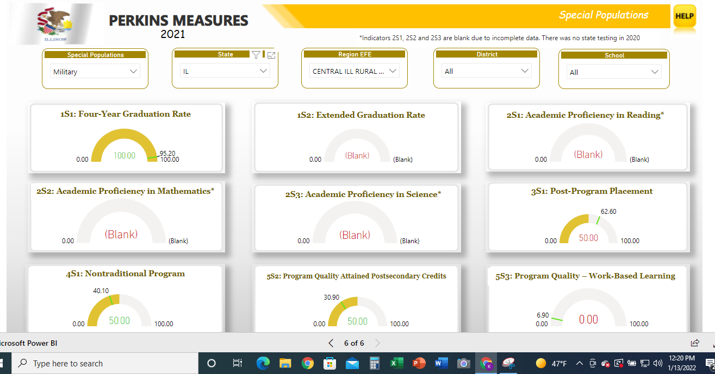
Special Populations Perkins Indicator Data for CIRR #425 CTE
Scoring color-coded key
Met Indicator Target | Met 90% Target | Indicator Target Not Met

Slide 9
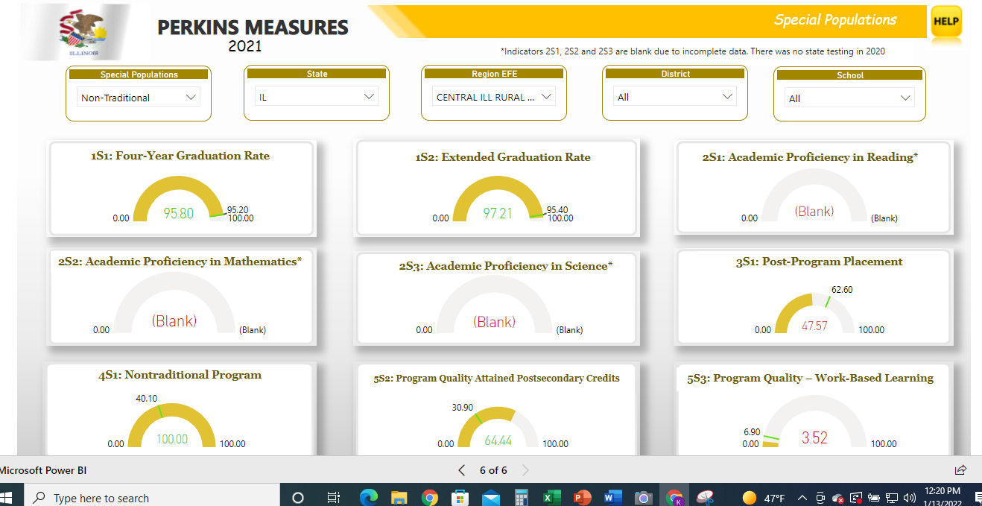
Special Populations Perkins Indicator Data for CIRR #425 CTE
Scoring color-coded key
Met Indicator Target | Met 90% Target | Indicator Target Not Met

Slide 10
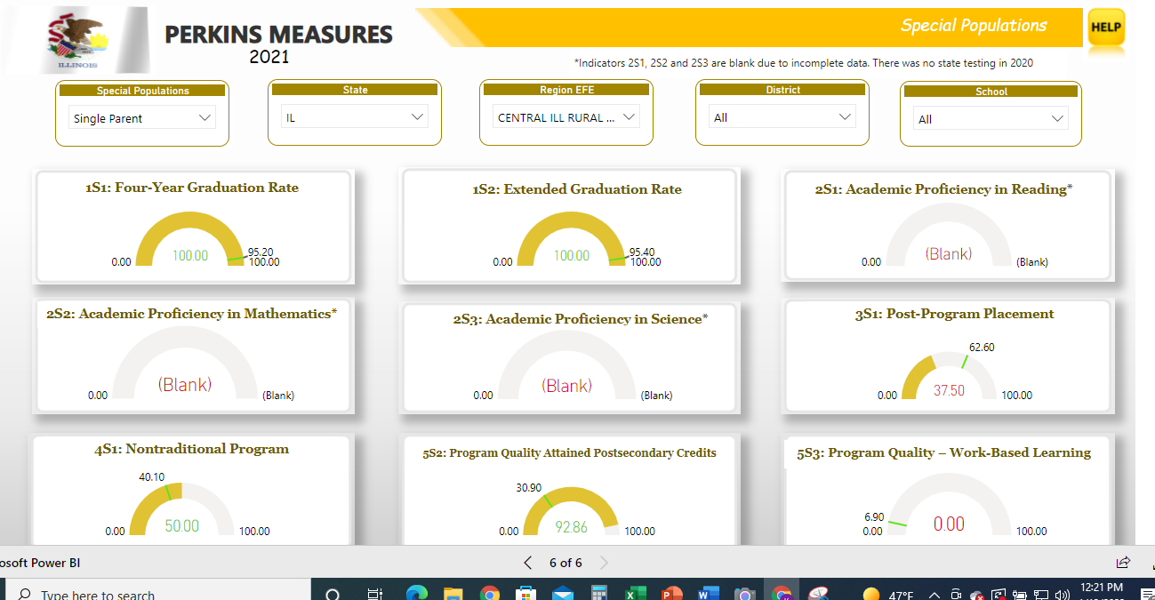
Special Populations Perkins Indicator Data for CIRR #425 CTE
Scoring color-coded key
Met Indicator Target | Met 90% Target | Indicator Target Not Met

Slide 11
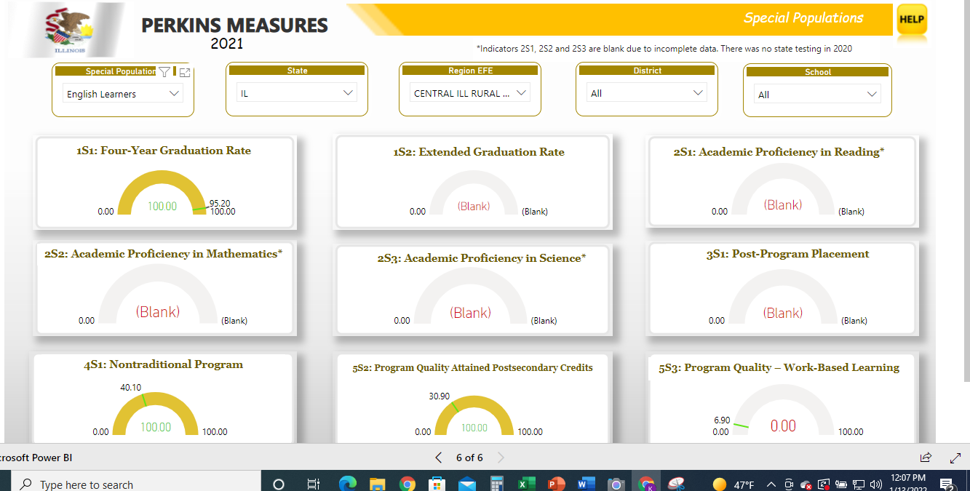
Special Populations Perkins Indicator Data for CIRR #425 CTE
Scoring color-coded key
Met Indicator Target | Met 90% Target | Indicator Target Not Met

